Slide 1













Vulnerability Assessment Framework
The VAF model
April 2015
Developed under Interagency Steering Committee oversight by UNHCR
Important Note: This is an intermediary presentation of VAF analysis. The results and analysis displayed in this presentation should not be shared or used for any other purpose.

Slide 2

In this presentation
The initial findings and analysis of the VAF baseline survey
The composition of the vulnerability assessments
The number of cases and the total number of individuals at risk for each sector
Highlighted areas where sectors may want to revise their models

Slide 3
Following this presentation - VAF next few months
Each sector will review their model and adjustments may be made to their algorithms
Once finalised, the VAF baseline data will be reanalysed and a report comparing the results of the VAF baseline data and the ongoing VAF home visits will be released
VAF multi-sectoral validation visits will be conducted
The MOU for VAF partners will be finalised
The VAF data collection and transfer SOPs will be finalised
A VAF Partner brochure/manual will be designed
The VAF excel dashboard will be coded in RAIS - including VAF monthly static reports
All VAF technical documentation will be uploaded to a module in RAIS
VAF will be rolled out (early May)
VAF training - skills transfer

Slide 4
Initial findings of the VAF survey

Slide 5
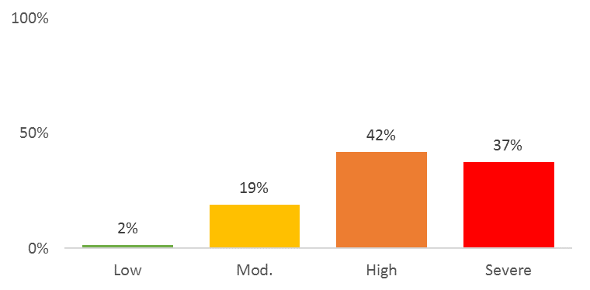
79% of the population are living below the poverty line
68 JOD
Jordan poverty line
Based on the VAF predicted welfare model
Predicted welfare is used instead of declared expenditure to:
Predict for households that cannot declare expenditure
Adjust for significant over and under reporting
Source data: VAF Model - Baseline survey, All data, 2,161 cases, Date of last visit: Jan - March 2015

Slide 6










East Jordan is the most vulnerable region
Universal indicators
3.07
6 out of 10 indicators are rated as Severely vulnerable
The average vulnerability of East Jordan is 2.71 out of 4
East Jordan is therefore rated as being Highly vulnerable
2.28
1.41
3.36
3.60
East Jordan
(Mafraq & Azraq)
1.65
3.29
3.03
3.47
1.95
Source data: VAF Model - Baseline survey, East region, 340 cases, Date of last visit: Jan - March 2015

Slide 7
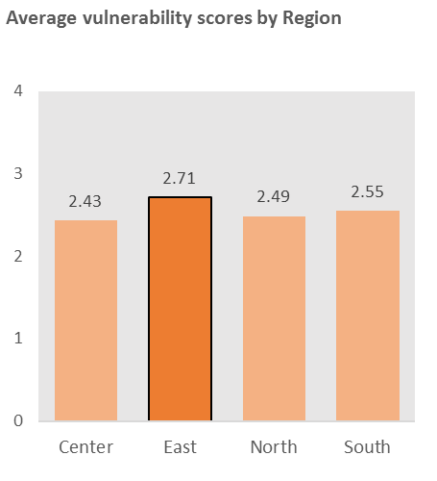
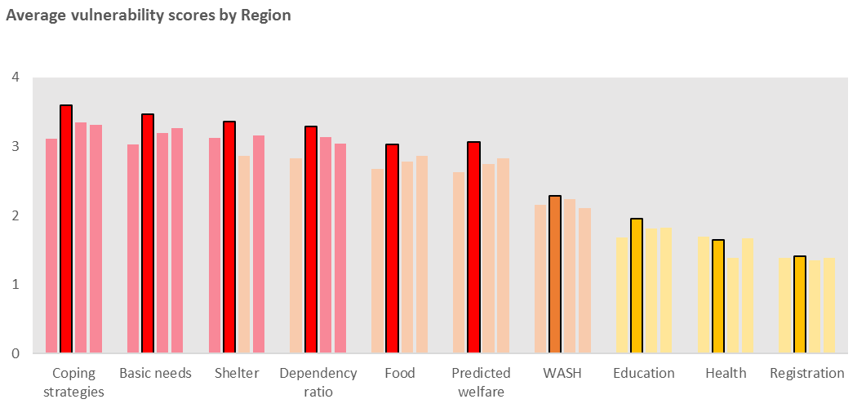
However there is little difference across the regions
The east is more vulnerable by a large margin for Basic needs, Coping strategies, Shelter and Predicted welfare
Source data: VAF Model - Baseline survey, All region segments, 1,424 cases, Date of last visit: Jan - March 2015

Slide 8
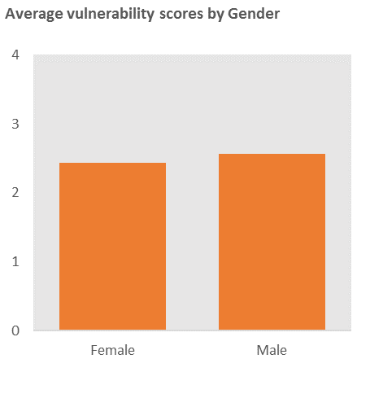
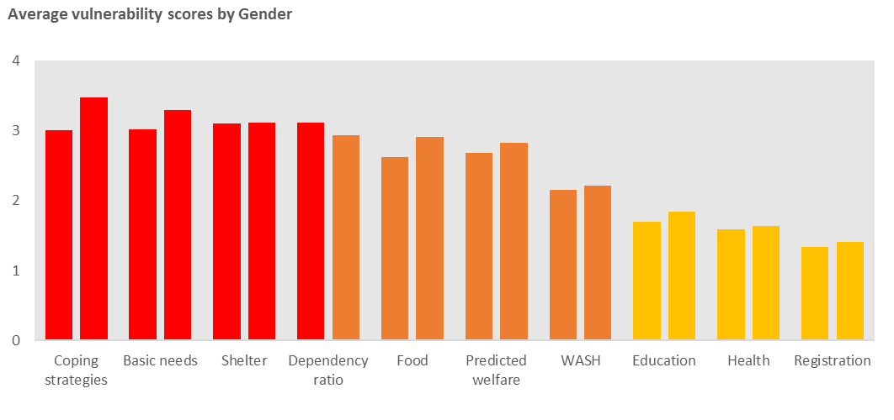


Male headed cases are marginally more vulnerable than female headed cases
Dependency ratio is the only indicator where female headed cases are more vulnerable than male headed cases
5%
Source data: VAF Model - Baseline survey, Male & Female segments, 737 cases, Date of last visit: Jan - March 2015

Slide 9

Case study: Profile of a moderately vulnerable case
 | Predicted expenditure 1 | Predicted per capita 387 JOD
 | Registration state 2 | PA registration PA is registered | Family registration n/a
 | Coping strategies 1 | No coping strategies being used
 | Dependency ratio 2 | 1 non-autonomous adult, 1 dependent Family size 1 or 2 | *There is inconsistency with PG & HV family size
 | Basic needs 1 | Coping strategies No coping strategies being used | Dependency ratio 1 non-autonomous adult, 1 dependent | Economic state No debt 194 JOD per month
 | Education 1 | Attendance risks 0 school aged children
 | Food 2 | Social vulnerability Dual headed house 1:1 dependency ratio | CARI score FCS = 65 39% spent on food
 | Health 1 | Access to services No problems | Family composition No 60+ or < 5s | Existing conditions No conditions 0 health expenditure
 | Shelter 2 | Housing conditions Missing 1 essential item | Security of tenancy No debt, has contract | Family composition Non autonomous adult
 | Wash 1 | Health No issues | Access to latrines Not shared and safe access | Access safe water Municipality source instances without | Waste management 1 instance water 1 instance solid
Universal indicators
1
1
1
2
1
Avg 1.3
2
1
2
1
1
Source data: VAF Model - Baseline survey, real case data

Slide 10

Case study: Profile of a highly vulnerable case
 | Predicted expenditure 2 | Predicted per capita 79 JOD
 | Registration state 1 | PA registration PA is registered | Family registration Family member is registered
 | Coping strategies 3 | 1 stress strategy being implemented (Stress 2) | 1 emergency strategy being implemented (Em 3)
 | Dependency ratio 4 | 1 non autonomous adult, 1 60+ Family size = 2
 | Basic needs 4 | Coping strategies Emergency strategies | Dependency ratio Poor dependency | Economic state High debt per capita
 | Education 1 | Attendance risks 0 school aged children
 | Food 3 | Social vulnerability Poor dependency Not single headed | CARI score FCS = 65, 38% spent on food, Emergency
 | Health 3 | Access to services No problems | Family composition 1 over 60 | Existing conditions High health expenditure (13%)
 | Shelter 4 | Housing conditions 3 signs of poor quality, Enumeratr judgement | Security of tenancy Has contract but high debt (775 JOD per cap) | Family composition Dependency ratio
 | Wash 2 | Health No issues | Access to latrines Not shared and safe access | Access safe water Municipality source No instances without | Waste management 1 instance water 1+ instance solid
Universal indicators
1
2
1
4
4
Avg 2.8
4
2
3
4
1
Source data: VAF Model - Baseline survey, real case data

Slide 11

Case study: Profile of a severely vulnerable case
 | Predicted expenditure 4 | Predicted per capita 39 JOD
 | Registration state 4 | PA registration PA is missing MOI | Family registration One family member is not registered
 | Coping strategies 4 | 1 stress strategy being implemented (Stress 2) | 1 emergency strategy being implemented (Em 5)
 | Dependency ratio 4 | 2 children 4 children 1 60+
 | Basic needs 4 | Coping strategies Emergency strategies | Dependency ratio Poor dependency | Economic state High debt per capita
 | Education 3 | Attendance risks Finance main risk | 3 school aged children 2 years missed edu 2 children attending
 | Food 4 | Social vulnerability High dependency ratio, Single headed | CARI score FCS = 7, 100+% spent on food, Emergency
 | Health 4 | Access to services Missing MOI, not had problems accessing | Family composition Under 5’s and over 60s in Case | Existing conditions High health expenditure (13%)
 | Shelter 4 | Housing conditions Fine | Security of tenancy Has contract but high debt (167 JOD per cap) | Family composition Male headed house High dependency ratio
 | Wash 3 | Health No issues | Access to latrines Not shared and safe access | Access safe water Municipality source No instances without | Waste management 0 instance water 1 instance solid
Universal indicators
4
2
4
3
4
Avg 3.5
4
3
4
4
3
Source data: VAF Model - Baseline survey, real case data

Slide 12
Review of the sector models
150 variables were used to create 79 new indicators of vulnerability

Slide 13
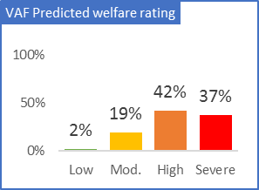
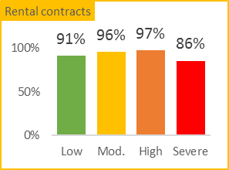
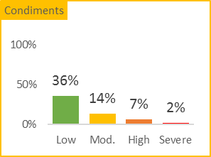
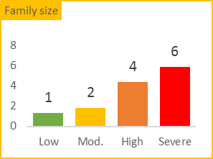
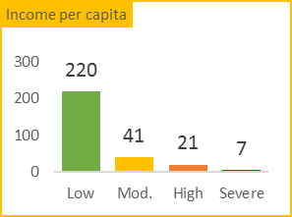
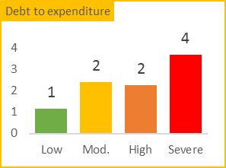
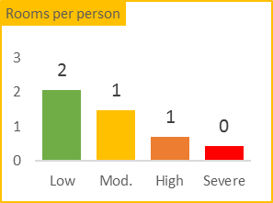
Predicted welfare
Vulnerability characteristics
+ 150 JOD
Predicted expenditure
- 41 JOD
Observations
58% of cases which represent 79% of the population are living below the Jordan poverty line of 68 JOD per month
Only 4% of cases are rated as having low vulnerability
* Percentage of population
Average characteristics that different vulnerability ratings display

Slide 14
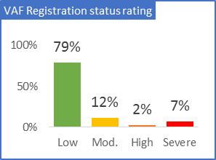
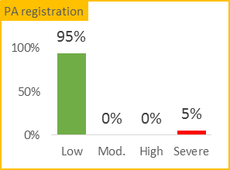
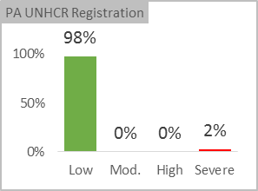
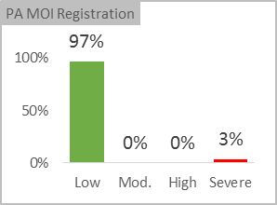
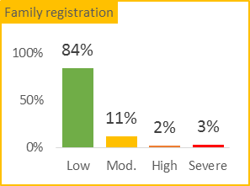
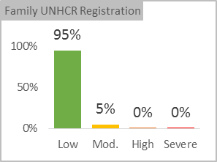
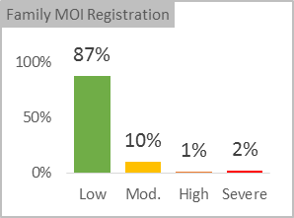
Registration status
Vulnerability characteristics
Fully registered
Fully registered
PA
Rest of family
Missing registrations
Missing registrations
Observations
92% of the population are at low to moderately at risk
Although there are instances of the PA missing documents, which is a critical risk, the numbers are low at 5%
The greatest risk has been identified as family members missing MOI documents and since this is required for access to Health services it has significant implications for family member’s health vulnerability
* Percentage of population

Slide 15
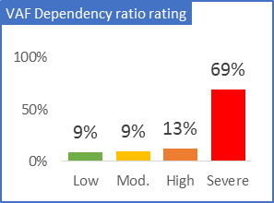
Dependency ratio
Vulnerability characteristics
0.6 Dependents to non-dependents
1.8 dependents to non-dependents
Ratio
Observations
67% of cases or 82% of population have a high dependency ratio of nearly two dependants to one non-dependant
A quarter of cases have more non-dependents to dependents
* Percentage of population

Slide 16
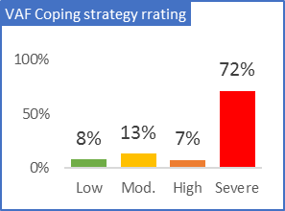
Coping strategies
Vulnerability characteristics
No strategies
Strategies employed
Emergency strategies
Observations
65% percent of cases are rated as high or severely vulnerable which represents 79% of the population
A further 9% of cases are rated as highly vulnerable
11% of cases are not implementing any coping strategies
* Percentage of population
No coping strategies
Stress coping strategies
(Case has spent savings, sold household goods or bought food on credit)
Crisis coping strategies
(Case has sold productive assets or reduced essential non-food expenditure)
Emergency coping strategies
(Case has sent adults or children household members to beg or to other high risk / illegal / socially degrading jobs)

Slide 17
Sector vulnerability ratings

Slide 18
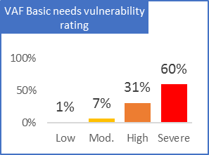
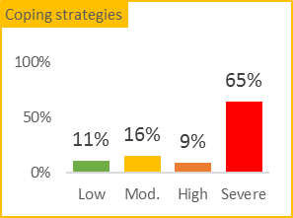
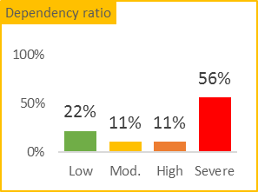
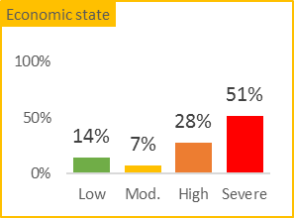
Basic needs
Vulnerability characteristics
Not adopting
0.6 : 1
Greater expenditure
Coping strategies
Dependency ratio
Economic state
Emergency strategies
1.8 : 1
Greater debt
Observations
The 79% of cases rated as high or severely vulnerable represent 91% of the population
Many cases are implementing emergency coping strategies and have high levels of dependency
Financial burden is created by debt being larger than expenditure
* Percentage of population

Slide 19
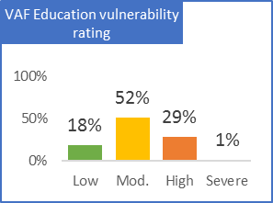
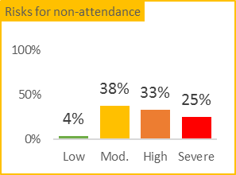
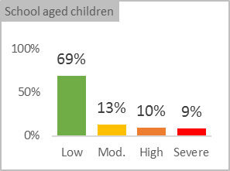
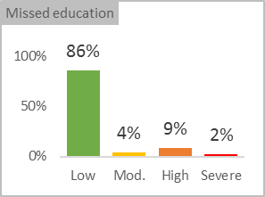
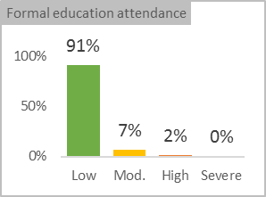
Education
Vulnerability characteristics
0 or 1
100%
0
None
No. of school aged children
Percentage attending school
Missed years of education
Risk factors for non-attendance
> 3
< 50%
3+ years
Physical, Social / Economic
Observations
16% of cases are rated as high or severely vulnerable which represents 30% of the population
School attendance is high and there are low levels of missed education
19% of cases need to put two or more children through school
It is the financial situation for most cases which is the biggest risk factor for missing school
* Percentage of population

Slide 20
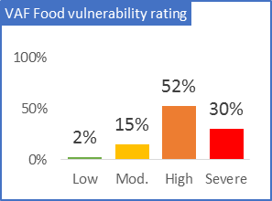
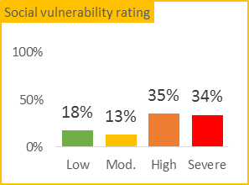
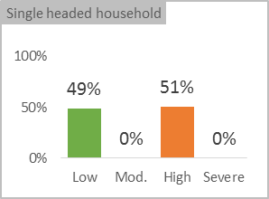
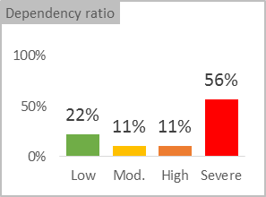
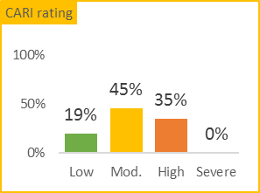
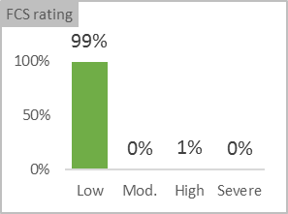
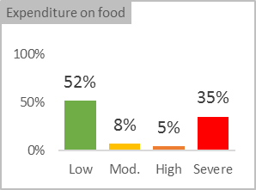
Food
Vulnerability characteristics
Low
Multi
High FCS score
< 25%
Dependency ratio
Head of household
Nutritious diet
Proportion of budget is spent on food
High
Single
Low FCS score
Majority
Observations
77% of cases rated as high or severely vulnerable which represent 86% of population
Nearly all cases have a positive CARI rating meaning that cases have a balanced diet and food does not represent a large proportion of expenditure
However there are other social vulnerability factors which indicate that three quarters of cases are highly vulnerable. 51% of cases are single headed and there is a high average dependency ratio.
* Percentage of population

Slide 21
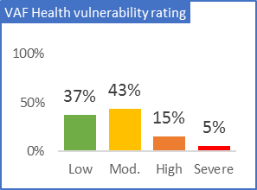
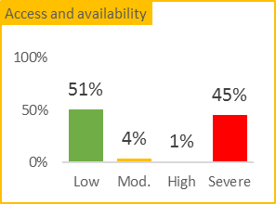
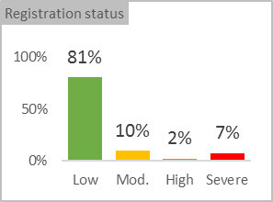
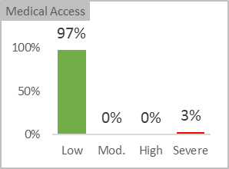
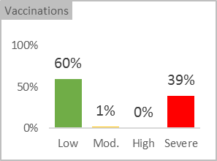
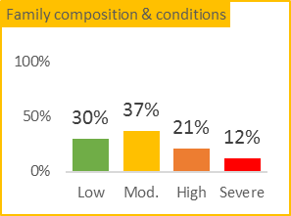
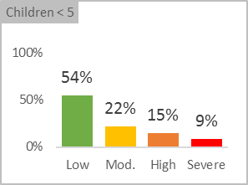
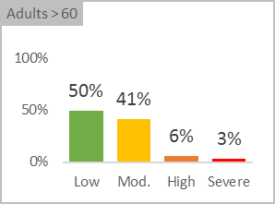
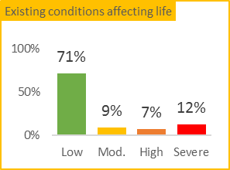
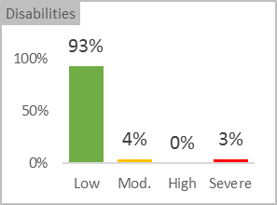
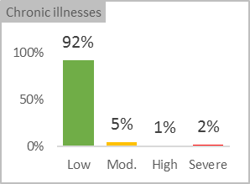
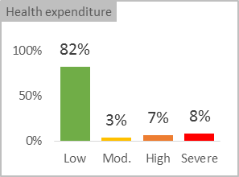
Health
Vulnerability characteristics
Complete registration & vaccination
No under 5s or over 60’s
No existing conditions
Access to services
Family composition
Existing conditions
Incomplete reg. or vaccinations
3+ under 5’s and over 60’s
Yes and negatively impacting life
Observations
20% of cases are rated as high or severely vulnerable which represent 24% of population
Access to medical services has been good however nearly all children are missing either polio or measles vaccinations, or both
There are high numbers of under-fives and over sixties in the cases which helps create a high dependency ratio
Overall there are low instances of disabilities or chronic illnesses negatively effecting work or daily life and most cases spend less than 5% on health
* Percentage of population

Slide 22
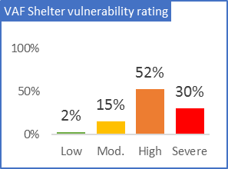












Shelter
Vulnerability characteristics
Fine
No debt, with contract
Low dependency
Housing conditions
Security of tenure
Family composition
Poor
High debt, no contract
High dependency
Observations
67% of the cases are rated as high or severely vulnerable which represent 83% of population
Three quarters of cases are at rated as highly vulnerable
House crowding and the quality of dwelling impact the overall housing conditions
There are many under 5’s and over 60’s as head of household and there are high dependency levels
While all cases are living in permanent accommodation there exist high levels of debt and instances without tenancy agreements.
* Percentage of population

Slide 23






WASH
Vulnerability characteristics
No incidents
Exclusive safe use
Pipe and consistent
No incidents
Low wash expenditure
WASH related illnesses
Access to facilities
Access to safe drinking water
Waste management
WASH Coping strategies
Many incidents
Shared and unsafe
Inconsistent and expensive
Regular problems
High WASH expenditure
Observations
18% of cases are rated as high or severely vulnerable which represent 19% of the population
There is a low rate of WASH related issues
Despite a large number of cases sharing latrines there is a good perceived sense of security
The supply of water is mostly provided by the municipality and has been reliable
Waste management, particularly from solids have experience problems in the last year
Although WASH makes up a small percentage of expenditure many cases are implementing emergency coping strategies
* Percentage of population

Slide 25
These slides are not in use

Slide 26


VAF style guide
Sector icons
VAF Logo
VAF colours
RGB
HEX
Low:
Moderate:
High:
Severe:
112,173,71
255,192,0
237,125,49
255,0,0
70AD47
FFC000
ED7D31
FF0000
3D619C
Nomenclature
Score
Rating
Steering committee logos

Slide 27
Case level vulnerability profile
Source data: VAF Model, Case number ____, Date of last visit __/02/2015

Slide 28
Case level vulnerability profile
Predicted expenditure 0.80
Registration state 0.70 | PA registration | Family registration
Coping strategies 0.80
Dependency ratio 3.00
Basic needs 2.70 | Coping strategies | Dependency ratio | Economic state
Education 1.60 | Attendance risks | Distance
Food 0.50 | Social vulnerability | CARI score
Health 0.60 | Access to services | Family composition | Existing conditions
Shelter 3.20 | Housing conditions | Security of tenancy | Family composition
Wash 3.80 | Health | Access to latrines | Access safe water | Wastewater
Source data: VAF Model, Case number ____, Date of last visit __/02/2015

Slide 29
Vulnerability in the East of Jordan
The average vulnerability of East Jordan is 2.83 out of 4
East Jordan is therefore rated as being Highly vulnerable
3.07
2.28
3.37
1.76
East Jordan
(Mafraq & Azraq)
2.24
3.60
2.81
3.63
1.95
3.55
Source data: VAF Model - Baseline survey, Case number ____, Date of last visit __/02/2015

Slide 30

Case level vulnerability profile
Universal indicators
0.80
3.80
0.70
3.20
0.80
0.60
3.63
0.50
2.70
1.60
Source data: VAF Model - Baseline survey, Case number ____, Date of last visit __/02/2015

Slide 31
Case level vulnerability profile
Source data: VAF Model - Baseline survey, Case number ____, Date of last visit __/02/2015

